Slide 1

Co-Dfns Compiler
Aaron W. Hsu
Indiana University

Slide 2

APL is fast. Who needs a compiler?

Slide 3

Compilers can enhance reliability and performance.

Slide 4

Interpreter Limitations
Scalar fusion leads to poor cache behavior
Procedure calls can be expensive
Common optimizations are not possible
No static analysis of code for errors or correctness

Slide 5

Co-Dfns is a headlong jump into APL compilation.

Slide 6

D-fns eliminates serious roadblocks to performance.

Slide 7

The interpreter can have poor cache behavior.
((⍟S÷X)+(r+2÷⍨v*2)×T)÷vsqrtT←v×T*0.5

Slide 8

Co-Dfns is for predictable, safe, controllable performance.
Tuning expertise should not be a black art.

Slide 9

Co-Dfns is a two-primitive extension of the D-fns language.
⌾
∥

Slide 10

Examples
X←5 5⍴⌾ ⍝ 5×5 single-assignment array
X[0;0]←3 ⍝ Set a single assignment cell
3≡X[0;0] ⍝ Reference a cell
?≡X[0;1] ⍝ Blocking call waiting for data
F∥¨ ⍝ Parallel Each
⍝ “Parallel” reduction of depth 1 vector
VECRED←{
Z[]←(⊃⍵),(¯1↓⍳⍴⍵)⍺⍺{Z[⍺] ⍺⍺ ⍵}∥¨1↓⍵⊣Z←⌾⍴⍨⍴⍵
}

Slide 11
Examples
TreeVecRed←{
}
Life←{⊃1 ⍵∨.∧3 4=+/,1 0 ¯1∘.⊖1 0 ¯1⌽¨⊂⍵}
LifeP←Life∥
LifeP2←{⊃1 ⍵∨.∧3 4=+/,1 0 ¯1∘.(⊖∥)1 0 ¯1⌽∥¨⊂⍵}

Slide 12

Why shouldn’t we be able to reason about performance?
ZPL and others make this a critical component.

Slide 13
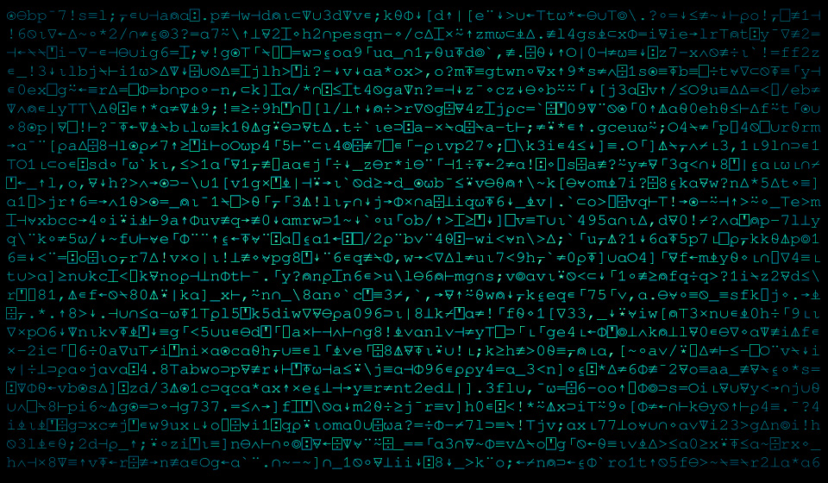
APL is math you can use. Let’s use it for performance.

Slide 14
Examples
Life←{⊃1 ⍵∨.∧3 4=+/,¯1 0 1∘.⊖¯1 0 1⌽¨⊂⍵}
⟨(⍴Life A) ←→ (⍴A)⟩
⟨Z F (Y F X) ←→ (Z F Y) F X⟩
F/⍵
⟨G DeepMap ←→ G⟩
X+Y G Z ←→ {x y z←⍵ ⋄ x+y G z} DeepMap X Y Z
←→ {⟨(,3)≡⍴⍵⟩ x y z←⍵ ⋄ x+y G z} DeepMap X Y Z

Slide 15
Examples
⟨(⍬≡⍴S)∧(F DeepMap ←→ F)⟩
M F (⍴M)⍴S → M F S
⟨(⍬≡⍴X)∧(X F Y ←→ Y F X)⟩
X F Y → Y F X

Slide 16

Plans and Schemes
Usable version this year
Target multi-core, GPU, and distributed clusters
Fully integrate with Dyalog
Focus on scalable parallel performance
Leverage APL-style formalism
Create a dialog between tuning expert and compiler

Slide 17

Version 1 will have low-hanging fruit optimizations

Slide 18

Interpreter vs. Compiler
Interpreter
Compiler
Garbage collected
Idiom-based special casing
No static verification
No user-guided optimization
Supports much more of APL
Numerous extensions
Stack-based allocation
Whole program optimization
Explicit verification and proof
Safe user-defined optimizations
Restricted to Co-Dfns
Limited extensions and interop

Slide 19

Using Co-Dfns should require less than trivial effort.

Slide 20
Demo time

Slide 21

Performance not included, some assembly required.
We’re not preaching super-compilation here.

Slide 22

Coding Goodies
Easily integrated with other code
A complete, useful, general parser for APL
A complete, rigorous specification of the language
Supports multiple runtimes
Language integration

Slide 23

Acknowledgments
Dyalog has provided significant funding and support.
PL Group at IU is a great place to test and strengthen these ideas.
John Scholes, for creating D-fns.
Intel’s Concurrent Collections
Mathematics of Arrays
C++ (Oh dear!)
NanoPass

Slide 24
Thank you
Email: awhsu@indiana.edu

Slide 25
Photo Credits
Hotnstock
MoonsongStock
Ladyaway
Fall_Stock
Estruda
Animalphotos
Dark_dragon_stock
Drezdany_stocks
Stupiddeeppeople
Thiselectricheart
Vampsstock
NefaroStock
NikiljuiceStock

